Slide 1
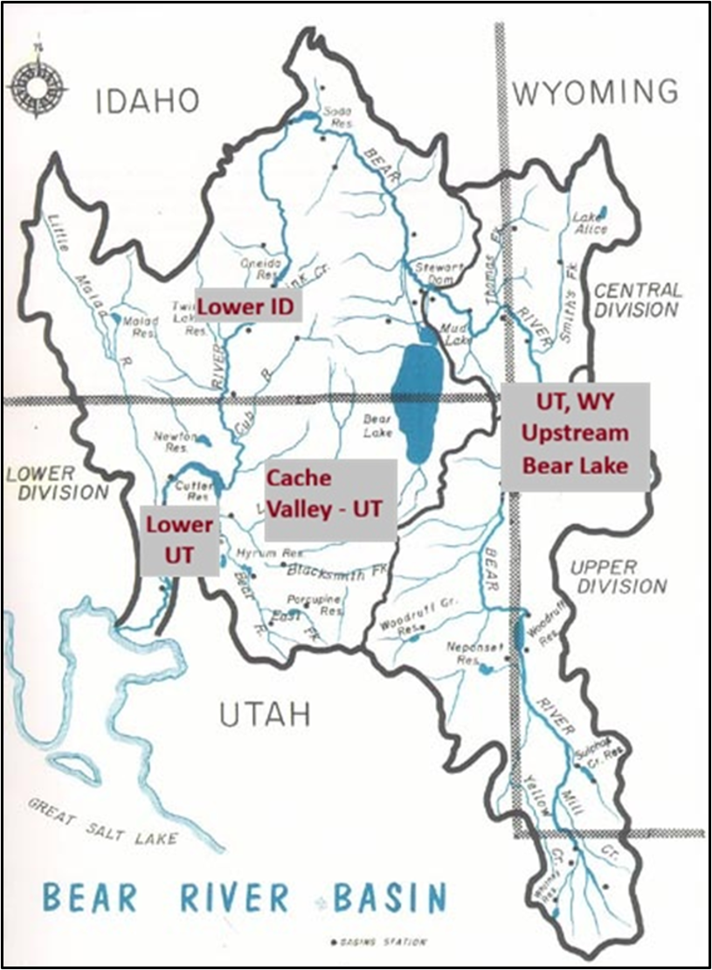
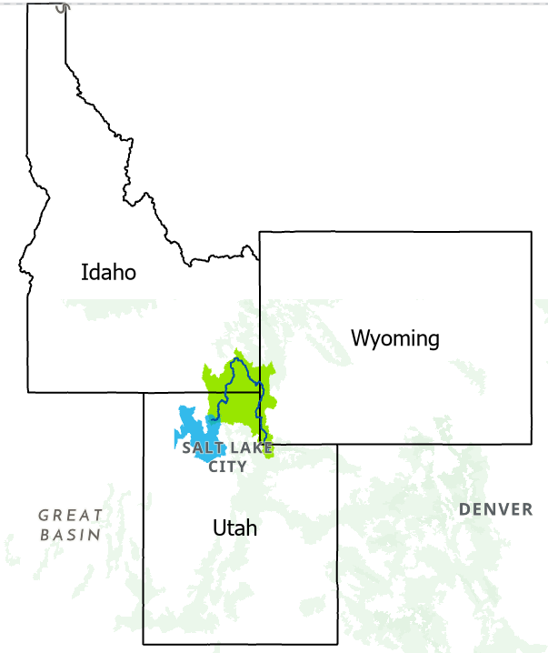
Immersive Model for a Tri-State Water Bank to Get More Water to GSL
Model Guide

Slide 2
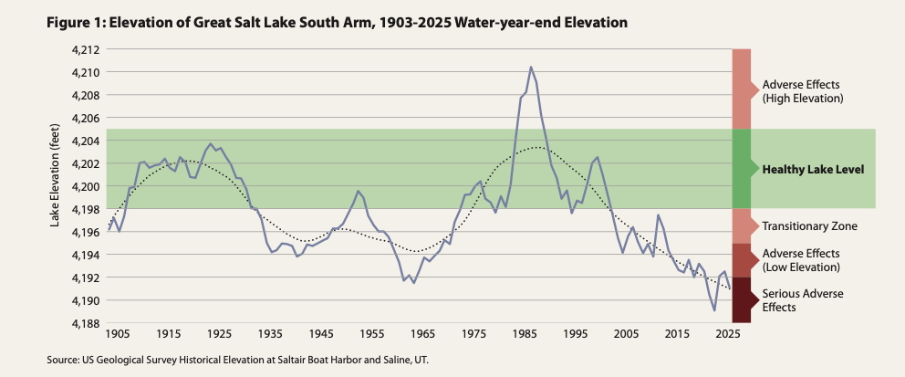
Healthy lake levels: 4,198-4,205 ft
Historic low : 4,188.5 ft (2022)
Mid 2026 ~ 4,190 ft
800,000 acre-feet of sustained additional inflow per year needed to return the lake to healthy levels (4,198 feet)

Slide 3
Representing agricultural uses.
All depletions occur in summer. Winter depletions are negligible.
Historical water use = proxy to allowable use.
Users can consume, conserve or sell water.
Users can only trade water with the bank.
One bank, two storage systems

Slide 4
Model Setup
Winter (Oct-Mar) Natural Flows
Summer (Apr-Sep) Natural Flows
Select from Natural Flow
October 1st
Specify Bear Lake Level
April 1st
Select Potential Target Elevation for Bear Lake
Summer
Available water
Decide Consumption
End of Summer
Bank storage in Bear Lake
Deliver to GSL from bank storage
Sell or Conserve remaining water
Negotiate Price with the bank
User Decision
Model Calculation
1- Define Strategy for Assigned User

